Slide 1
Capstone Design Week11 Presentation
2016124099 박관영
2016124103 박상준
2016124124 사재현
2016124145 양해찬

Slide 2
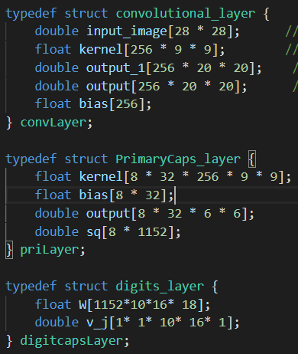
Capsule Net inference on C
>>>
구조체를 통해 Layer 생성,
각 layer의 input, output matrix를 정의

Slide 3
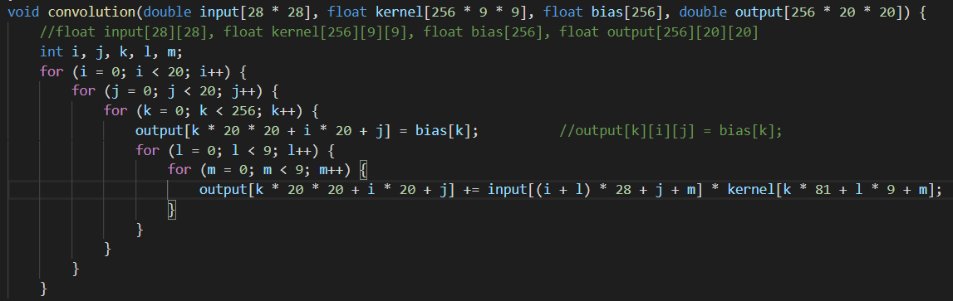
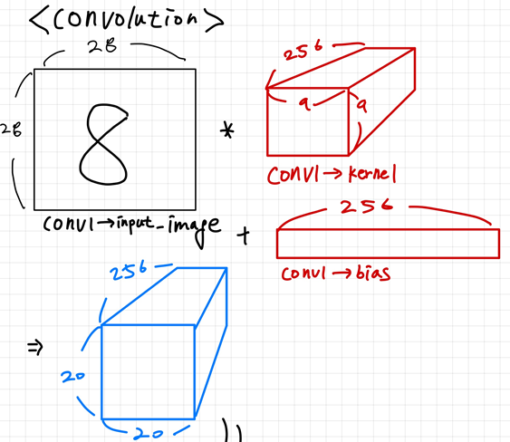
Capsule Net inference on C – convolution
>>>
첫번째 convolution layer
(28, 28, 1) ➔ (20, 20, 256)

Slide 4
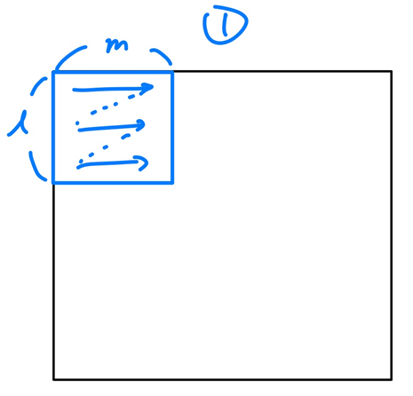
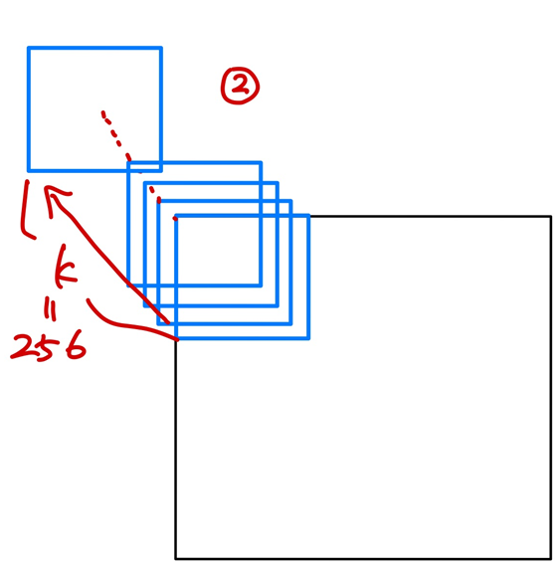
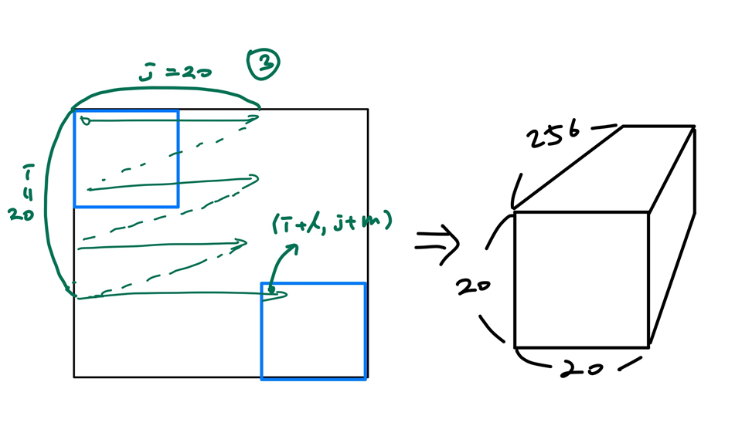
Capsule Net inference on C – convolution

Slide 5
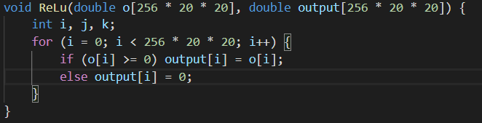
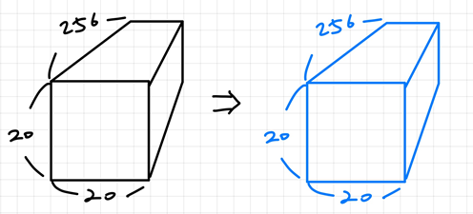
Capsule Net inference on C – ReLU
>>>
(20, 20, 256) ➔ (20, 20, 256)

Slide 6
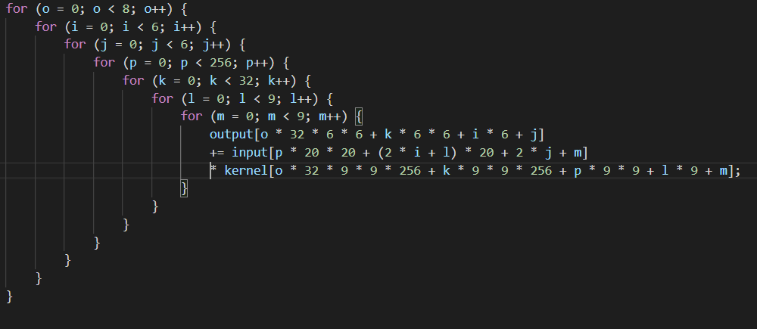
Capsule Net inference on C – Conv_pri
>>>
(20, 20, 256) ➔ (8, 32, 6, 6)

Slide 7
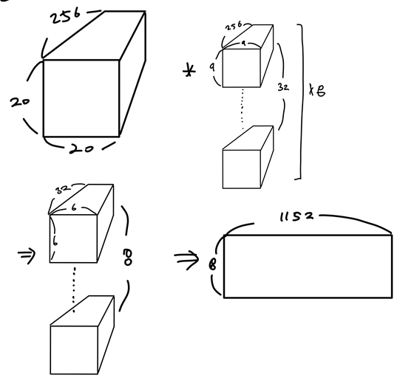
Capsule Net inference on C – Conv_pri

Slide 8
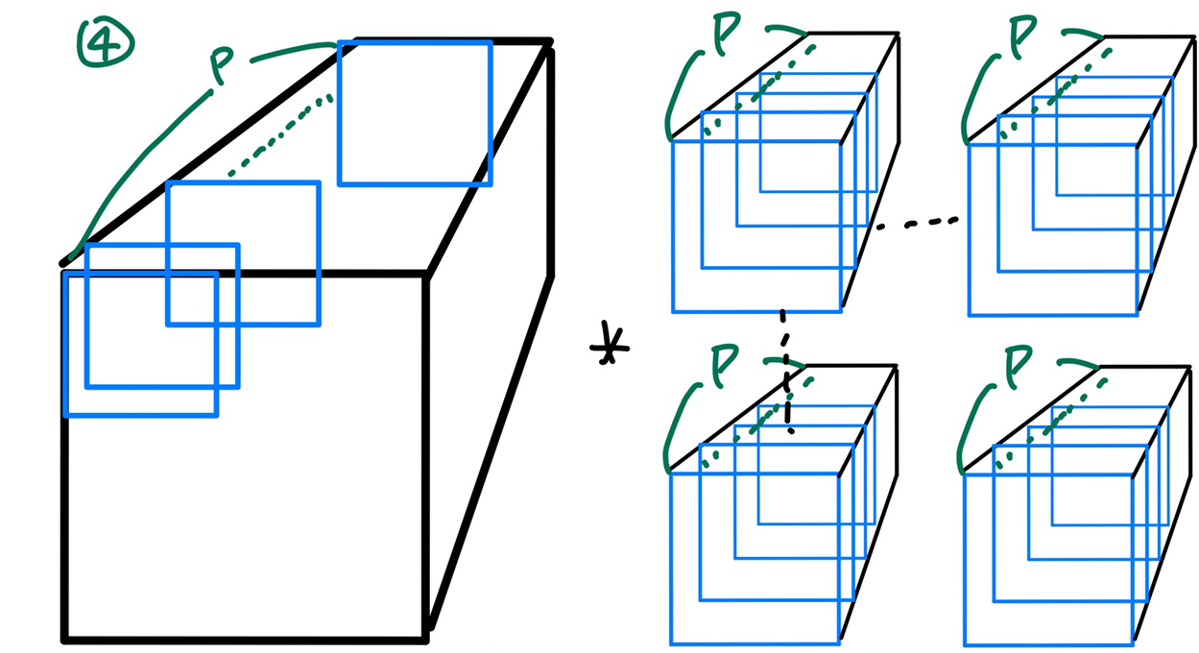
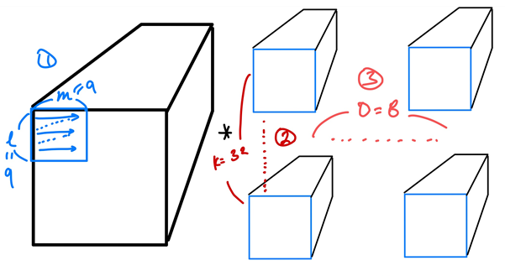
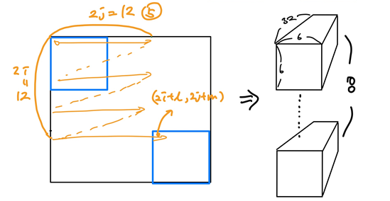
Capsule Net inference on C – Conv_pri

Slide 9
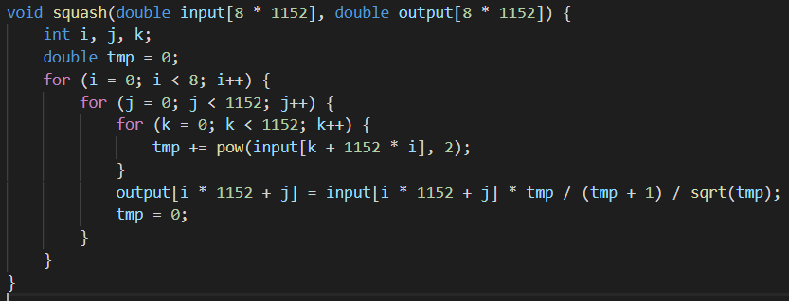
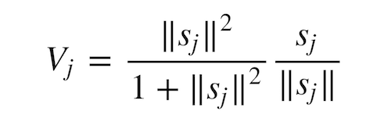
Capsule Net inference on C – Squash

Slide 10
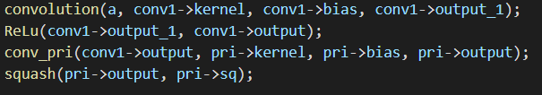
Capsule Net inference on C – main
>>>
Convolution => ReLu => Conv_pri => squash

Slide 11
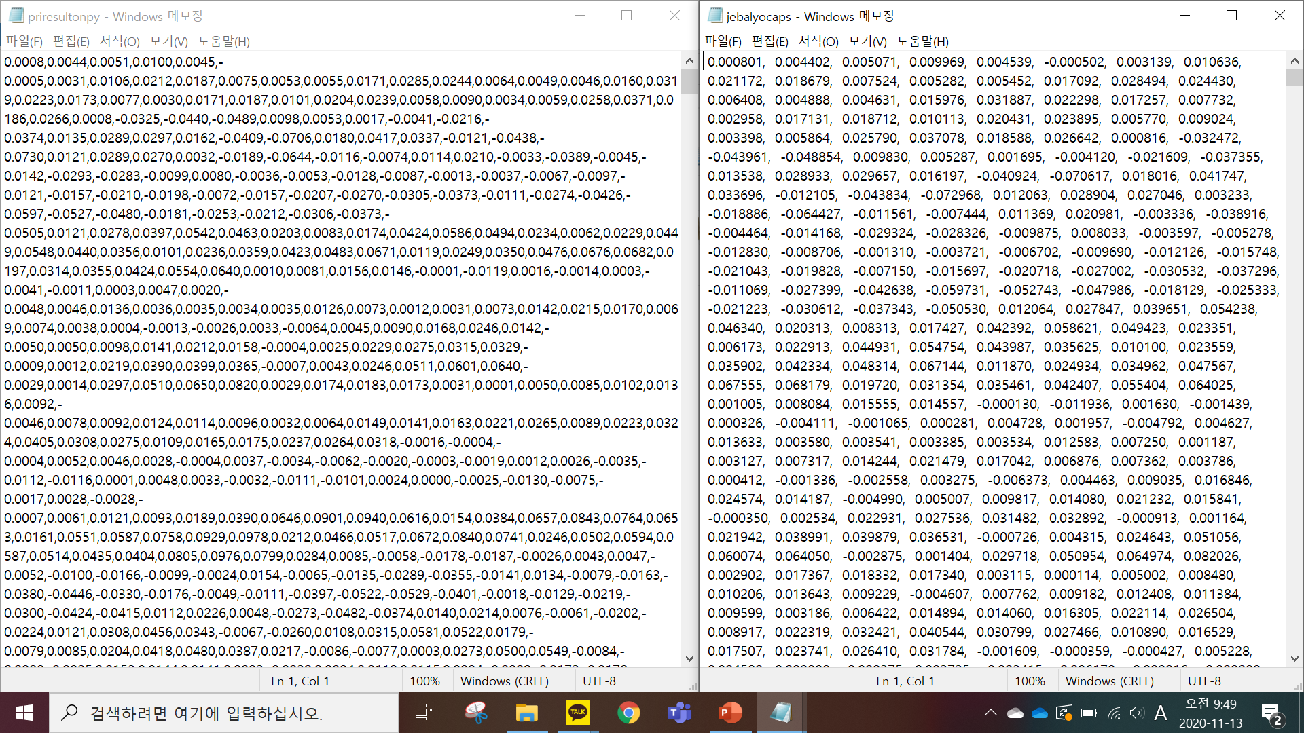
Capsule Net inference on C – main
Pytorch
C

Slide 12
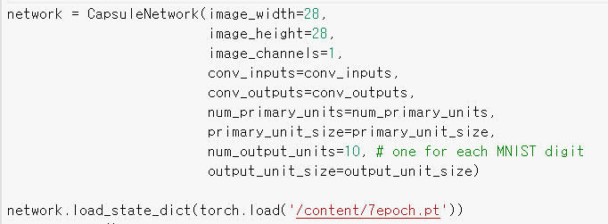
trained model
Save & load trained model
7epoch:

Slide 13
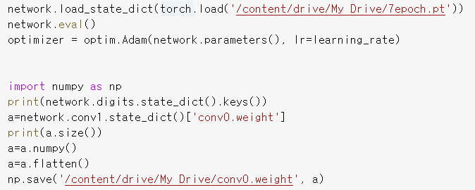
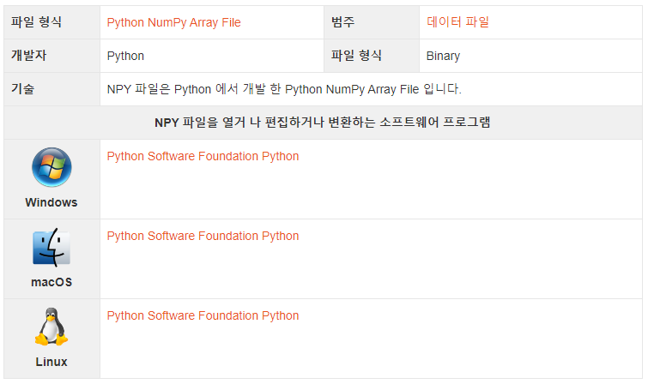
np.save
Save parameters to .npy file

Slide 14
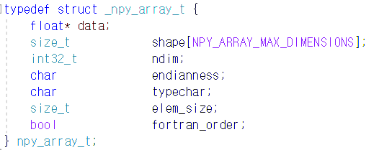
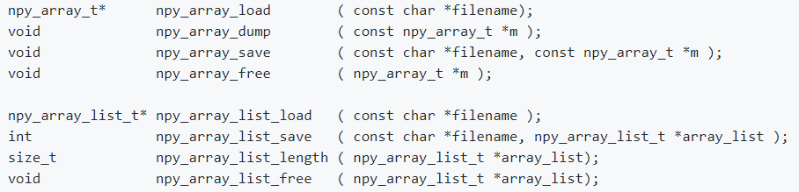
np.save
.npy file on C
https://github.com/oysteijo/npy_array
API
Weight, bias 는 float 형

Slide 15
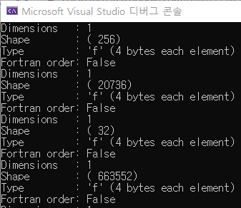
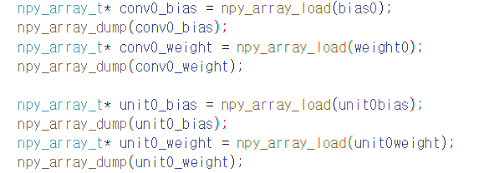
load parameters on C
.npy file on C
Weight, bias 는 float 형.
npy_array_t -> data 에 2진수 data의 주소가 담김

Slide 16
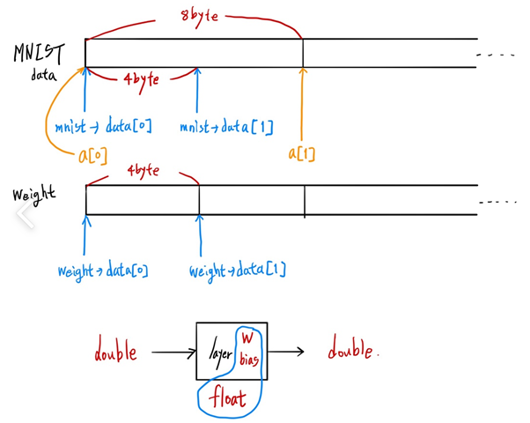


Data type
Data type
MNIST Image는 binary 8byte 값을 가짐
Weight와 bias는 4byte이므로 double * float 연산이 진행됨
➔ Weight와 bias값을 제외하면 double형을 유지해야함

Slide 17
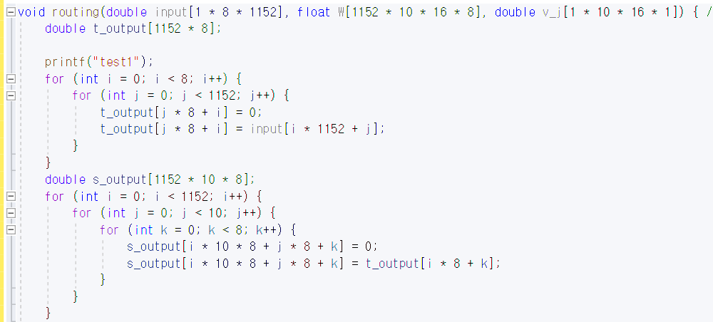
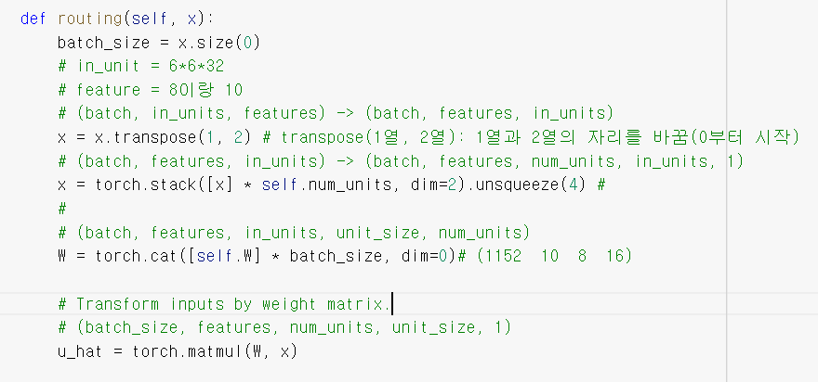
Routing – transpose, stack
>>> transpose
>>> (1152, 8)
>>> stack
>>> (1152, 10, 8)
>>> primary vector 차원을 맞춰주는 함수
(8, 1152) ➔ (1152, 10, 8)

Slide 18
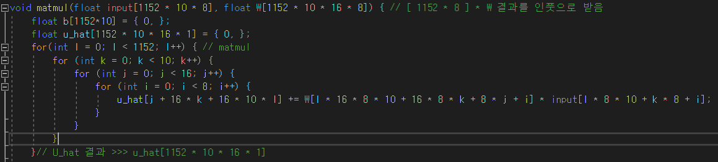

Routing - Matmul
>>> (1152, 10, 16, 1)
>>> (1152, 10, 16, 8) $×$ (1152, 10, 8, 1) ➔ (1152, 10, 16, 1)
>>> (16, 8) $×$ (8, 1) ➔ (16, 1)

Slide 19
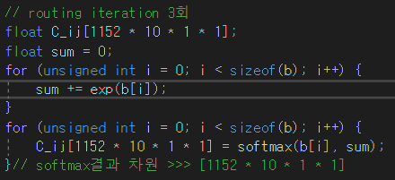
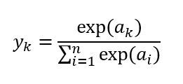
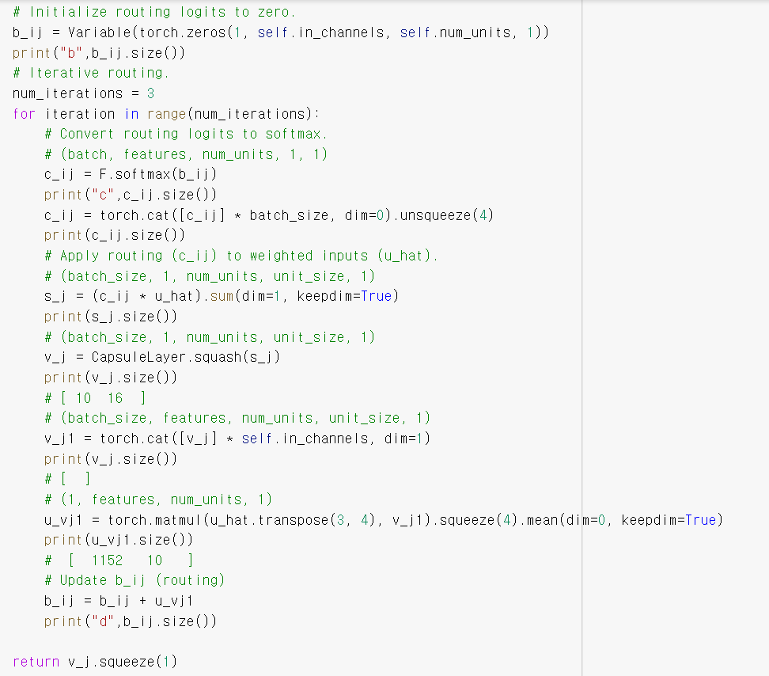
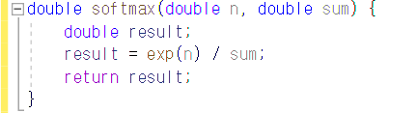
Routing - Softmax
>>> scalar에 대한 softmax

Slide 20
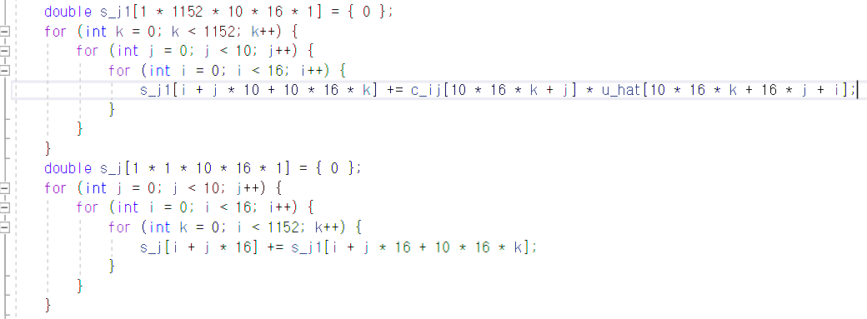
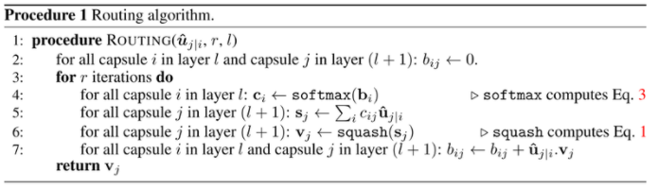
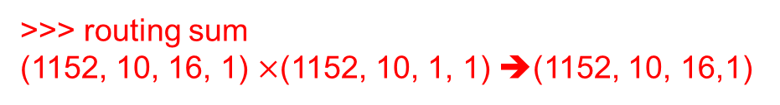
Routing – routing sum
C_ij =Scalar -> 16개 결과
>>> routing sum
(1152, 10, 16, 1) $×$(1152, 10, 1, 1) ➔(1152, 10, 16,1)
>>> 위의 결과 1152 차원에 대해 sum
>>> (1, 10, 16, 1)

Slide 21
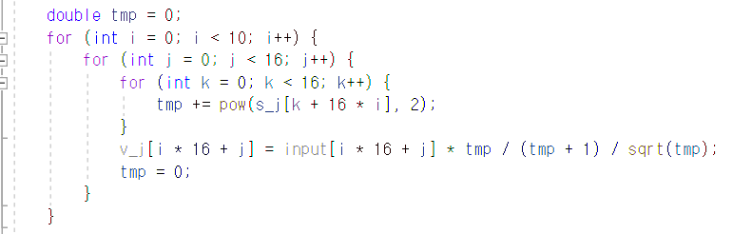

Routing - squash
>>> squashing
>>> pow : 제곱 연산
>>> (1, 1, 10, 16, 1)

Slide 22
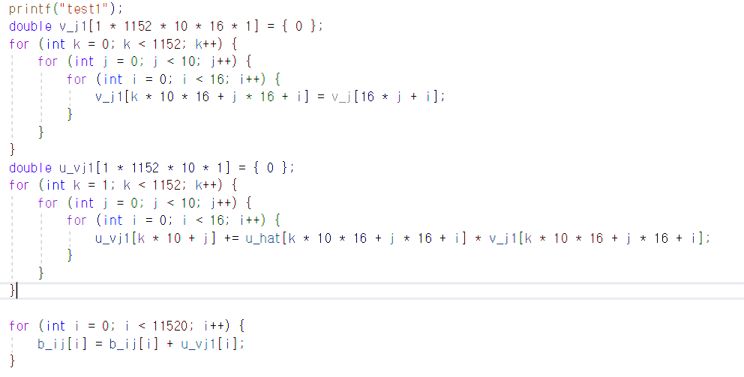
Routing – routing weight update
>>> v_j => (1, 1, 10, 16, 1)
>>> torch. cat
>>> (1, 1152, 10, 16, 1)
>>> u_hat => (1, 1152, 10, 16, 1)
>>> cosine simularity
>>> (1, 1152, 10, 1)
>>> routing update
>>> (1, 1152, 10, 1)

Slide 23
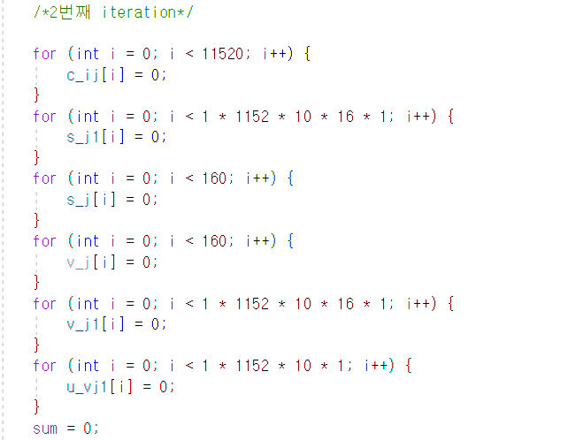
Routing
>>> 다음 iteration에서 사용될 변수 초기화

Slide 24
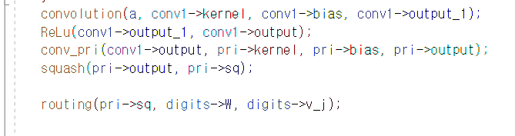
Main
>>> main 함수 호출

Slide 25

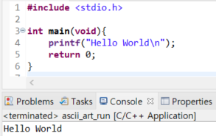
Eclipse

Slide 26
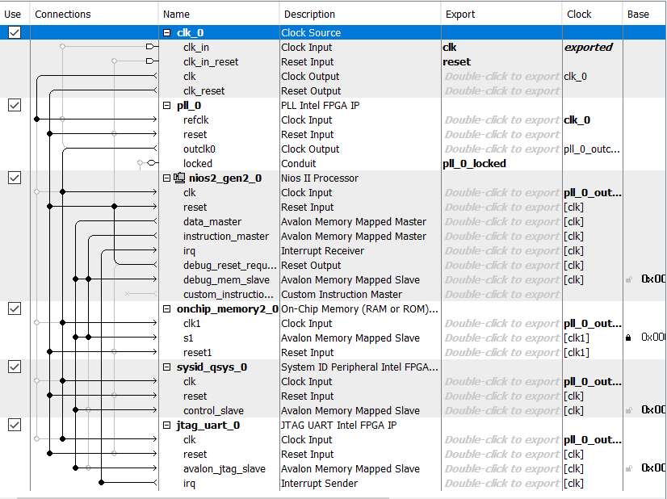
Platform Designer

Slide 27
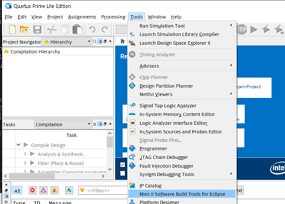
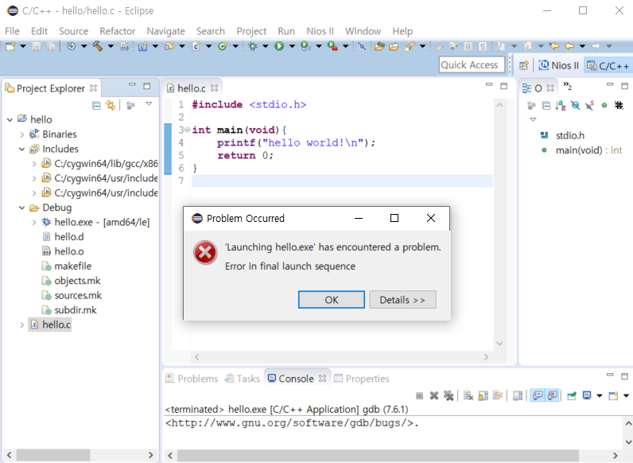
Quartus

